Slide 1
Nora Kennedy
Continuous Testing – Preparing Integration Data

Slide 2
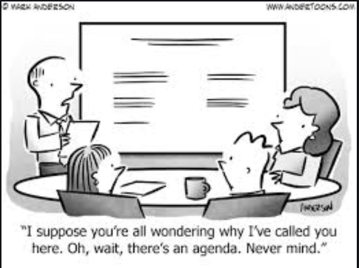
Agenda
About Us
Pipeline Services
Test Data as a Service at GMF
Evolution
Design
Implementation
Common Mistakes
Next Steps

Slide 3


Company: GM Financial
Team: Autobots
Cross functional
Collaborate with operations
Designs SDLC frameworks
Coach other groups on best practices
Co-Data Designer: Anna Ramadoss
Team lead
Pretty epic person
About Us…

Slide 4

How to Pipeline Services?

Slide 5
Sink, Swim and Drift
Talented Ops Engineers
Strategic Planning
Talented
Developers
Config and
code drift
Low code
solutions
Transformation
Maintenance
nightmares
All Hat and No Cattle

Slide 6
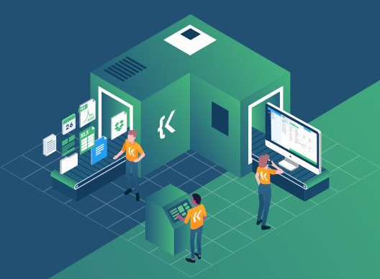
Test Data as a Service

Slide 7
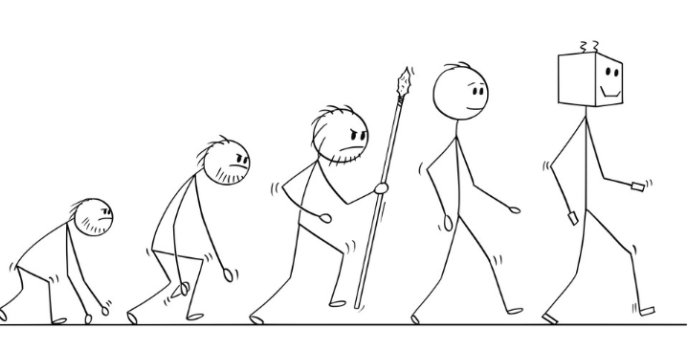
Evolution of Data Generation
Manually created
Automating components locally
Self-service data creation
Remote execution of automation
Test data as a service

Slide 8

Identify Data Components
Test Data Requirements
Primary Variables
Field Dependencies
Data Outputs
Injection Points
Data Format

Slide 9

Testing Integration Stage
Develop
Commit
Build
Scan
Deploy to Stage
Test Stage
Release
Azure DevOps Task Group - Testing
Staging data
Running test automation
Data Engine API
POST Test data request
Run test data generation automation
Run Test Automation
GET Test data parse results
Run test automation

Slide 10
Test Data as a Service
Unify inputs and outputs of test data for test automation
Leverage Azure DevOps task groups to run data prep services
Benefits
Increases transparency
Consolidates processes
Standardizes data requests
Increases security and decreases access requests

Slide 11
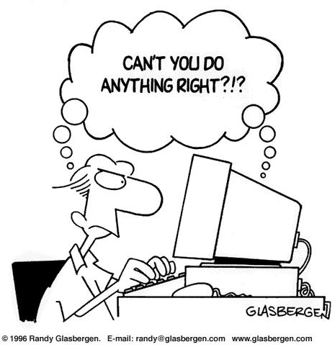
Learn From our Past MIsTkes

Slide 12
Empathy
Work with users, understand what they need
Make processes flexible and give users options
Educate
Setup knowledge transfers
Leverage Azure DevOps Repo Wikis
Empower
Create common task jobs and grant user access
Setup lab/sandbox environments to promote innovation
Think E³

Slide 13
Avoid Duplication
Identify - stakeholders and keep them informed
Communicate - pipeline features, ability and changes effectively
Design Smart - use object-oriented programs for core functions*
*Think Python PEP 20 – The Zen of Python

Slide 14

Next Steps

Slide 15
Expand Data Service Features
Create Advance Reporting Hooks
Identify and Create Test Automation Templates
To Do….

Slide 16
